Slide 1


System Intelligence Report:
Statistics Training #1
Date of report:
Report author:
SRO:
Clinical lead:
Report produced by the Nottingham and Nottinghamshire ICS System Analytics & Intelligence Unit

Slide 2
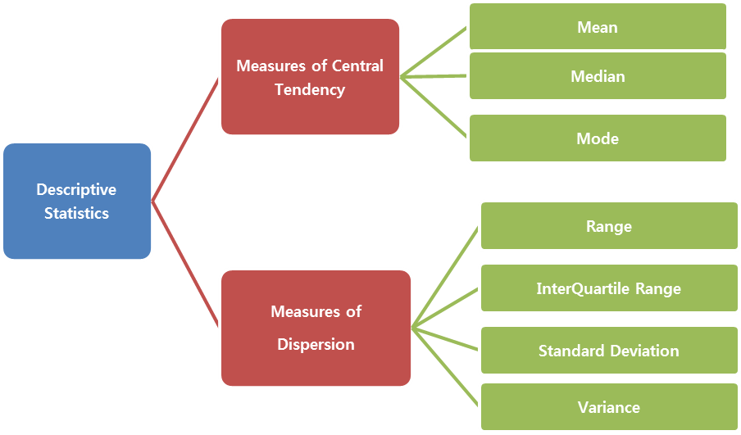
Why Are Data Types Important?
Type of Data Helps Determine How To:
Summarise
Analyse
Visualise
Apply Statistical Methods
DISCRETE
CONTINUOUS
Statistics-Chapter 1: Numerical Measures, accessed 13.07.24
https://medium.com/@Vishva_Shah/statistics-chapter-1-numerical-measures-f0abca02872a

Slide 3
Discrete & Continuous Data
CONTINUOUS
DISCRETE
Quantitative/Numerical
Categorical
Quantitative/Numerical
Pain rating scale
Length of stay (LOS)
Birth weight
Patients in ED (ED occupancy)
Doctors in a workforce
Ethnicity
Binary (e.g. has disease, does not have disease)
Ambulance handover time

Slide 4
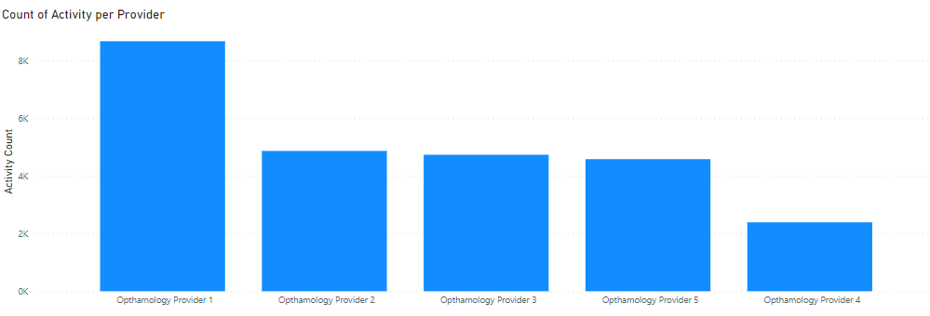

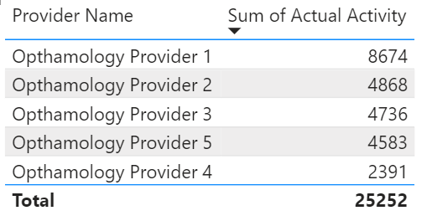
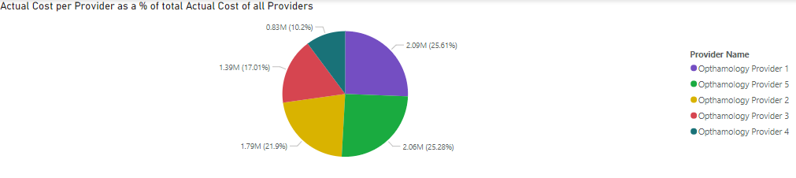
Discrete Data
NOT A HISTOGRAM
QUESTION: WHAT’S THE DIFFERENCE BETWEEN A BAR CHART AND COLUMN CHART?

Slide 5
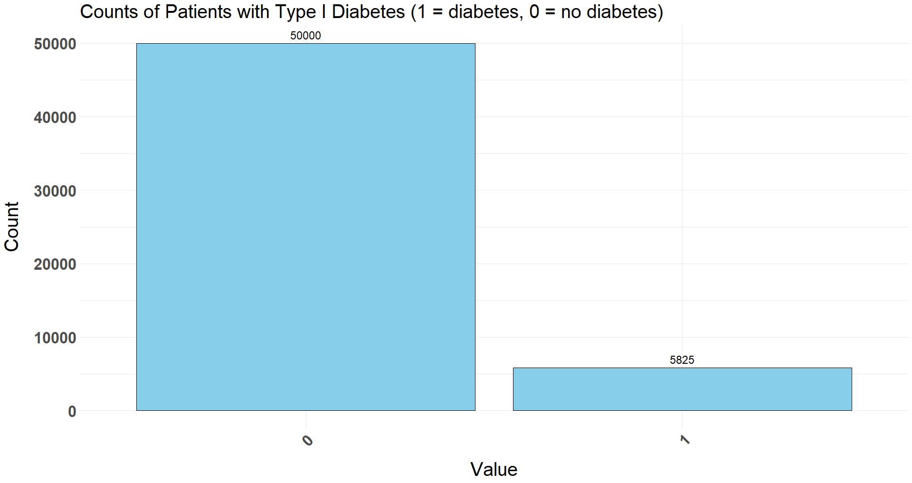
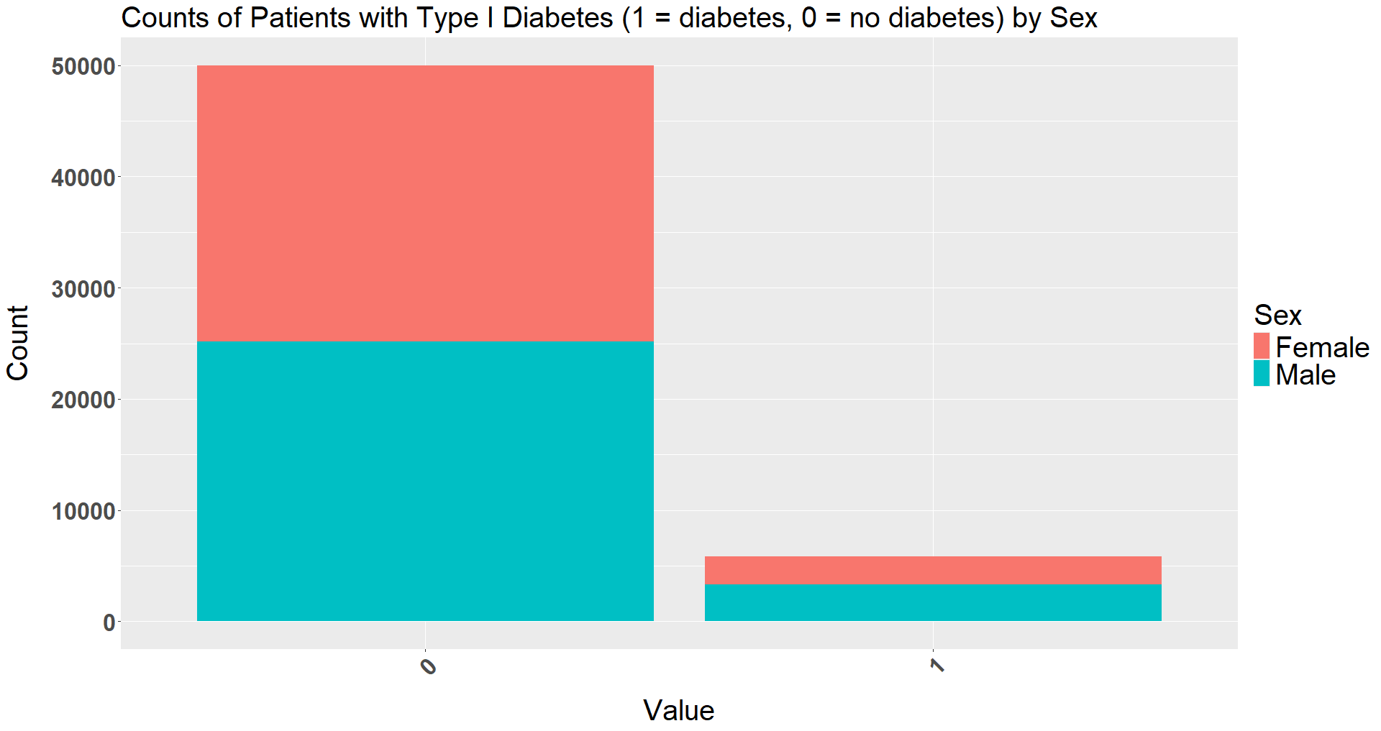
Discrete Data

Slide 6
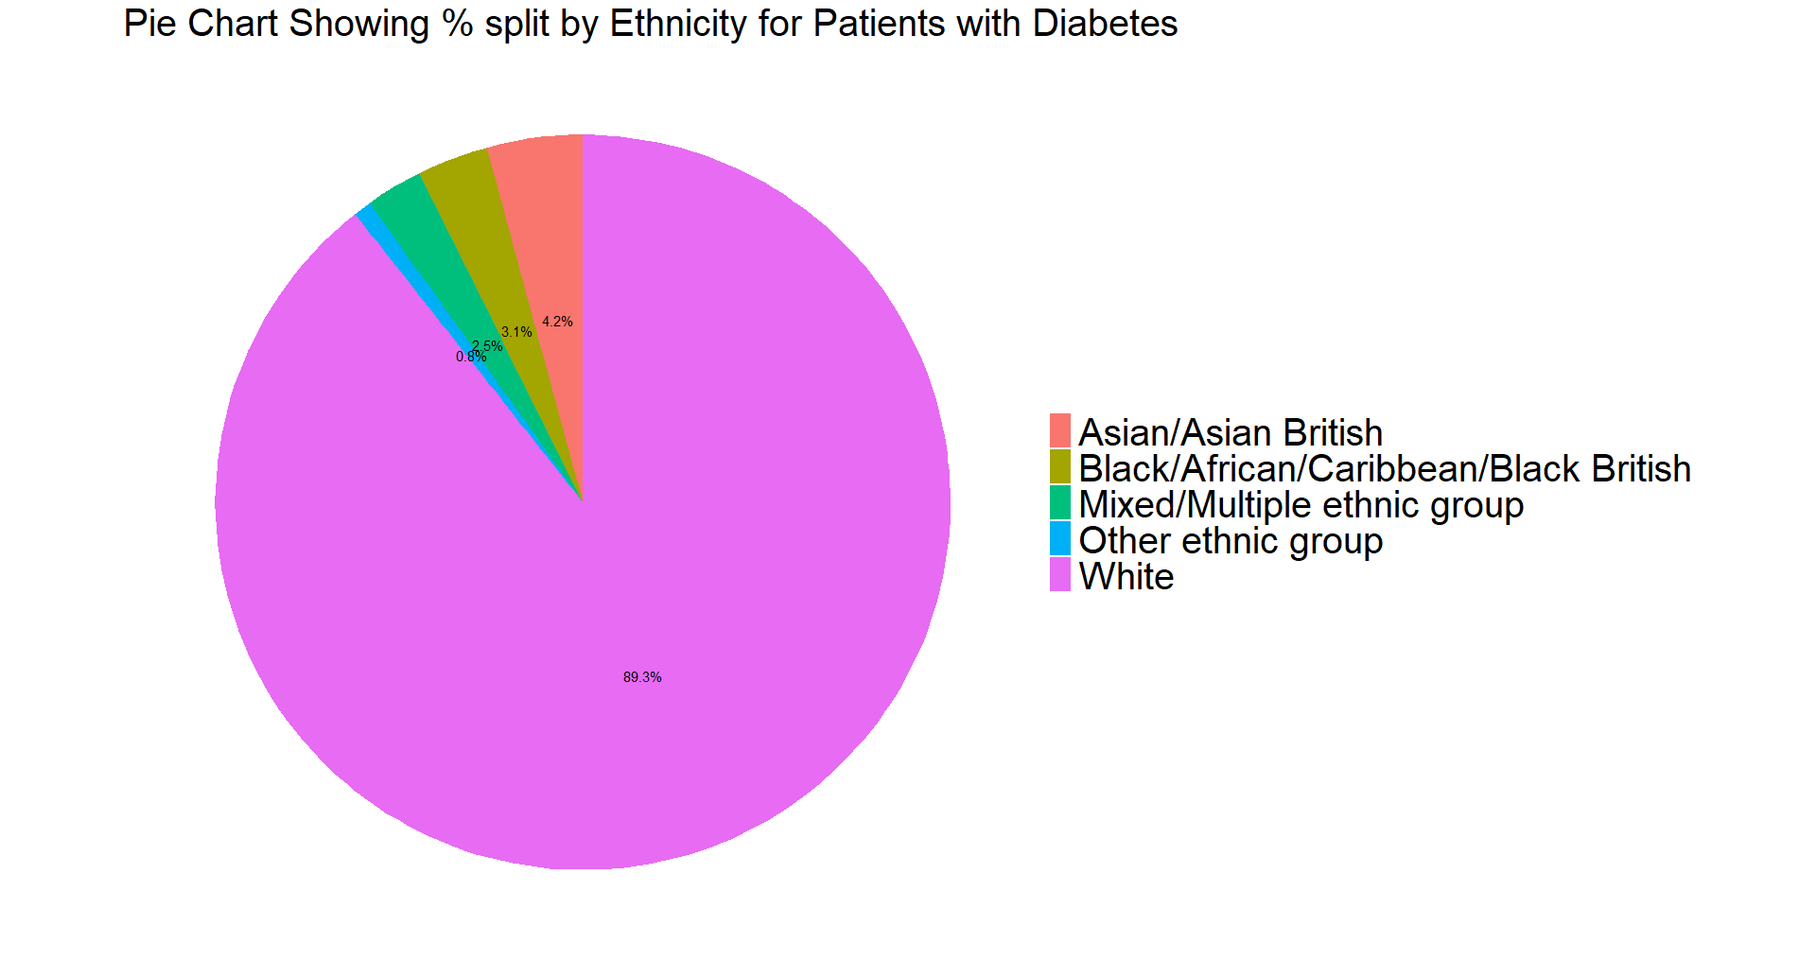
Discrete Data

Slide 7
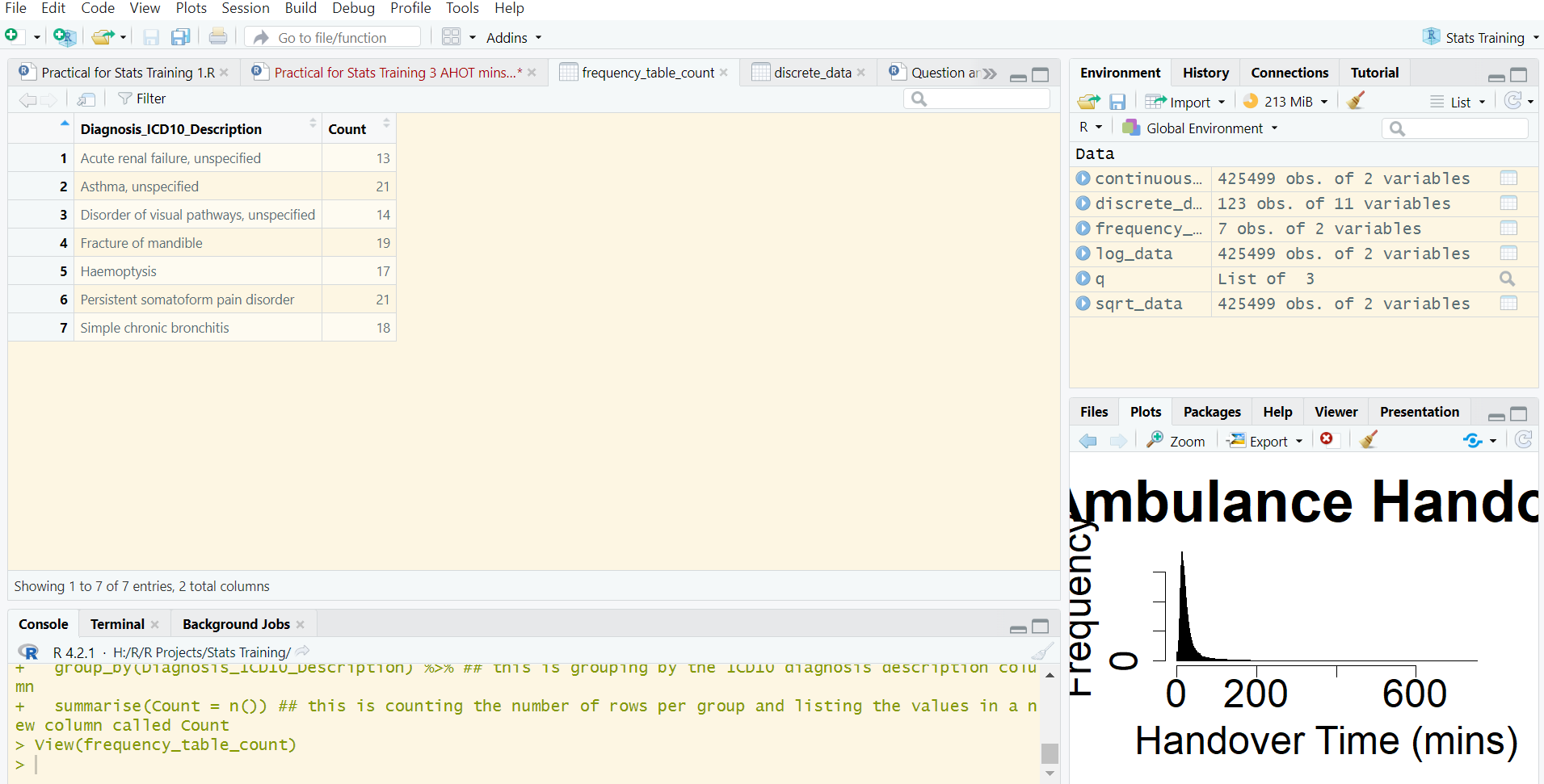


Practical Sessions – Setting Up
All:
Go to our github page using the QR code (https://github.com/Nottingham-and-Nottinghamshire-ICS/Statistics_training_1)
To download files specified below, click on the file (located near the top of the GitHub page) and then click the download image (near the pencil icon towards the right). Download the Statistics Training Notes now if you prefer
R:
Download the Data for Statistics Training NNICB data Excel file, Statistics Training Practical R file, and Statistics Training Answers R file from the GitHub page
Create a new project in R and save all files mentioned above in your project folder (ask if you need any help)
Comments throughout the R file are essential to understand the code – please read them!
Run lines 4-22 to install the required packages, read the libraries, and read the data
Click Environment, discrete_data to familiarise yourself the data we will use next. If you get a chance, take a look at the continuous data as we will be using that later
Google Colab:
If you want to use R but don’t have it installed locally, you can use Google Colab, accessible via the GitHub page (go to the README for the link) (If you have R installed but prefer to use Colab, download the Statistics Training Answers R file from the GitHub page so you can see model answers in your R Studio)
Click the dropdown arrow in the top right next to Gemini and select Connect to a hosted run time
Run cells 1 & 2 by clicking the play button in the top left. Have a look at the first few rows of data that appear
Excel:
Download the Data for Statistics Training NNICB data Excel file and go to the “Synthetic_Discrete_Inpatient” tab. Look at the data to familiarise yourself with it.
Throughout this session, we will be creating charts and tables in using this data. Sometimes, we want to manipulate the data for certain charts, but not ones we have already made. To avoid this, you can copy each chart after you have made it and paste it AS A PICTURE, perhaps in a new sheet, so you always have a reference image saved
For pivot tables (explained later) you might want to copy and paste a new pivot table to edit each time we make changes
Throughout the practical slides, you may see a blue coloured cell reference at the end of some steps – these refer to example charts/tables in the Excel_Model_Answers tab of the Statistics Training NNICB data Excel file
Don’t worry if this doesn’t make perfect sense – I will show you what I mean when we start the next practical
Github page to download data and required resources

Slide 8
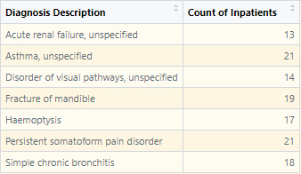
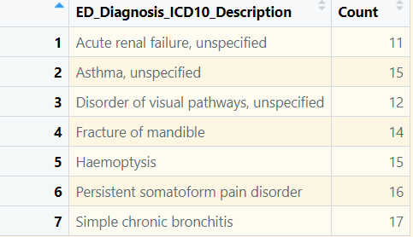
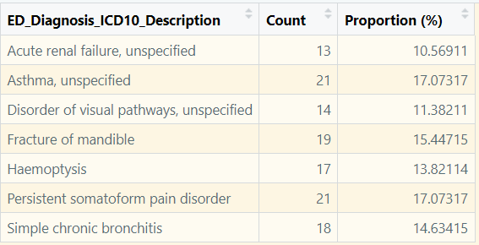
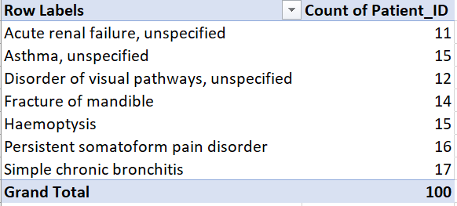
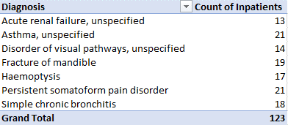
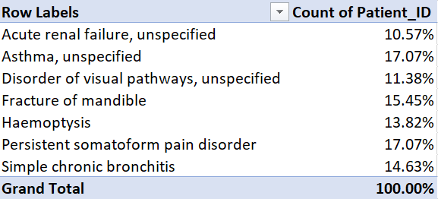
Discrete Data Practical – Frequency Tables Part 1
R:
Run lines 37-40 (highlight & cntrl+enter) to create the first frequency table which counts the number of inpatients with each diagnosis. Have a look at the output (opens in new window)
Run lines 45-49 to create the same frequency table, but with proportions instead of raw values
Have a go at question 1 (lines 54-64) to rename the ICD10 column to something easier to understand
Excel:
In the Synthetic_Discrete_Inpatient tab, highlight row 1 for the columns A-K and press cntrl+shift+down
Click Insert, Pivot Table in the ribbon, make sure New Worksheet is selected, and click Ok
Go to the pivot table you created and drag Diagnosis_ICD10_Description into rows and Patient_Id into values (ensure this is count not sum. If sum, click on Patient_Id in the pivot table fields on the right, left click Value Field Settings, and select count) (A3)
To view this data as proportions rather than raw values, right click on one of the values in the pivot table and select Show Values As, % Of Column Total
Convert back to raw values by right clicking on a value, Show Values As, No Calculation
Have a go at question 1 in the Questions tab to rename the ICD10 and Count column to something easier to understand (D3)

Slide 9
Discrete Data Practical – Frequency Tables Part 2
R:
Run lines 70-77 by highlighting and pressing ctrl+enter to create a new frequency table that is split by diagnosis and sex, and to rename the columns and view the table. You can now see the counts of inpatients with each diagnosis, split by sex
Have a go at task 2 to split the data by ethnicity instead of sex. There are some hints in the R file next to the task in case you get stuck.
Have a go at task 3 to create your own frequency table. If you get stuck, ask for help or have a look at the Example Answers R file, but try to do it on your own first.
Excel:
Add Sex as a second variable. Drag Sex to Rows under Diagnosis_ICD10_Description Then remove Sex (easiest way is to untick from list in pivot table fields) and instead drag it to Rows above Diagnosis_ICD10_Description . You can see which output you prefer. (A14)
Have a go at the question 2 in the Questions sheet to split the data by ethnicity instead of sex. There are some hints in the Hints column of the Questions tab in case you get stuck (D14)
Have a go at question 3 to create your own frequency table. Have a look at the hints column, the Excel_Model_Answers tab, or ask for help if you get stuck, but try and have a go yourself first. (A48)

Slide 10
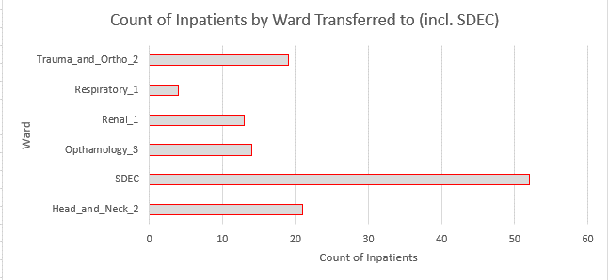
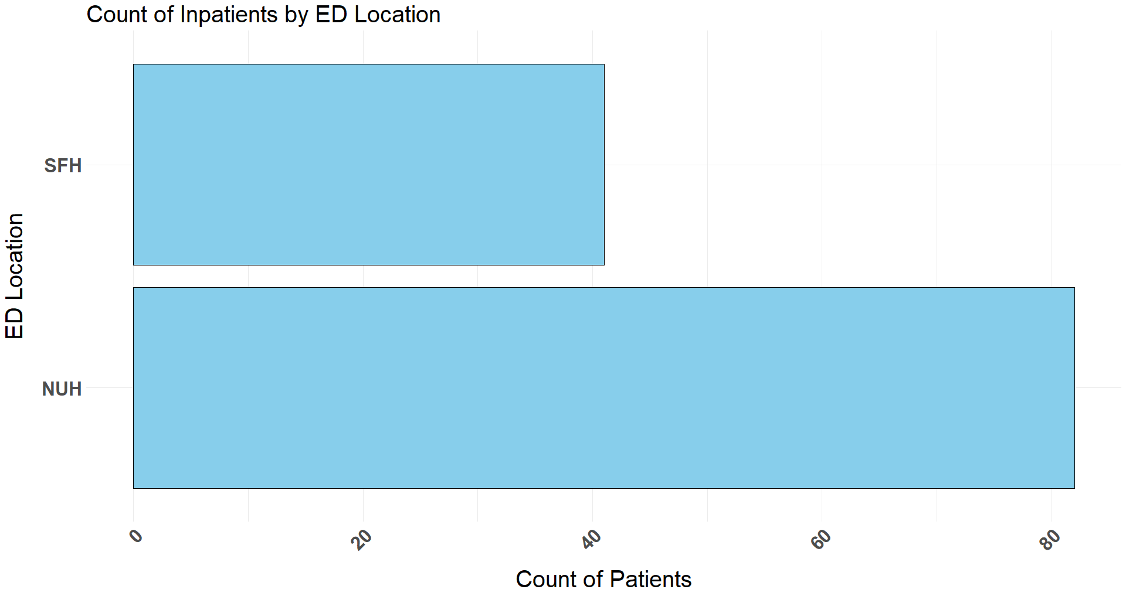
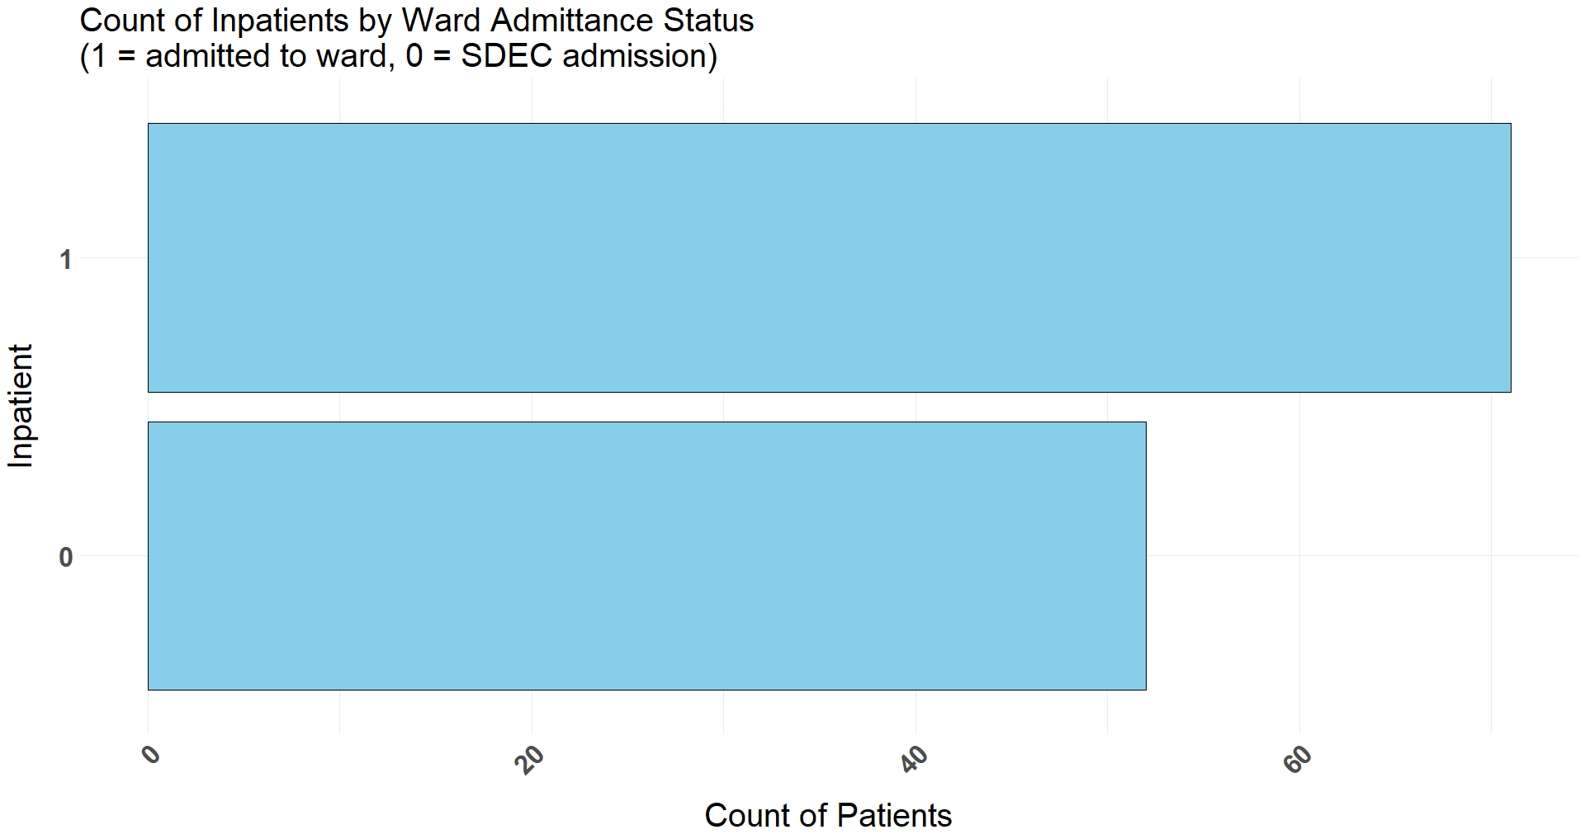
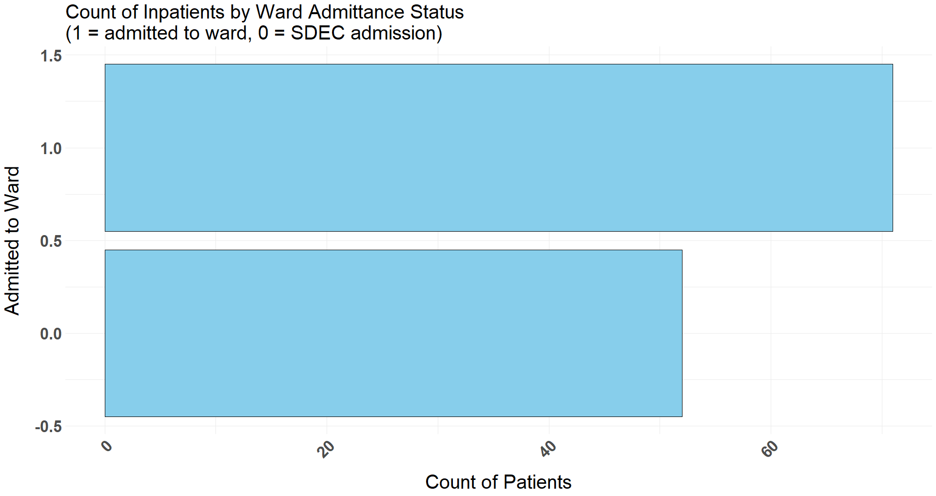
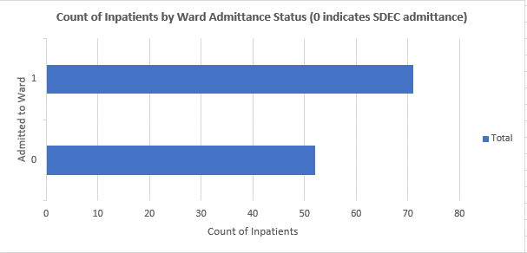
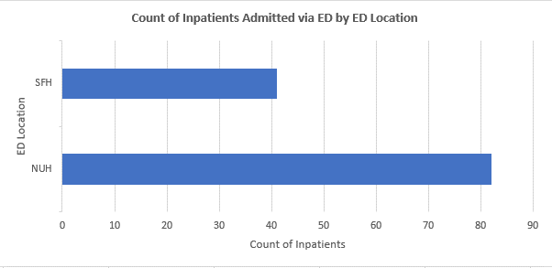
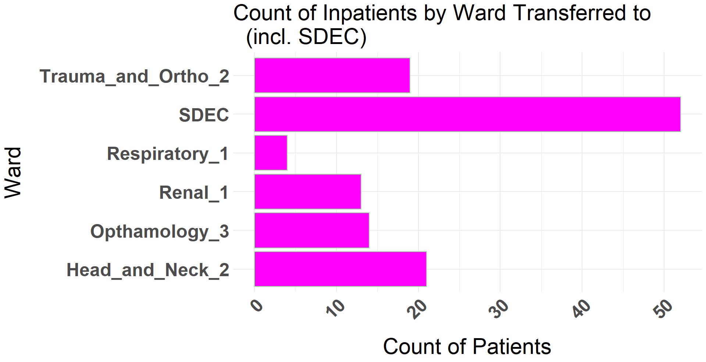
Discrete Data Practical – Bar Charts Part 1
R:
Run lines 122-125 to make a simple column chart showing the count of patients per ED location that they arrived through.
Then run lines 129-141 to run customised code that creates a bar chart. Remember to read the comments!!
Run lines 145-157 to create a bar chart that shows the number of inpatients that were admitted to a ward (rather than SDEC).
Have a go at question 4 and then we will discuss the answers together.
Run line 169-181 to convert the categorical variables to factors, and then run lines 184-196 to create the improved bar chart
Have a go at the task 5 to create a new bar chart
Excel:
Go to your pivot table and remove any variables from the Rows. Add only ED_Location to the Rows field. Leave Count_of_Patient_Id in the Values field (A70)
The column names may have remained the same as when you previously renamed them. If so, rename them to something more suitable
Click on the pivot table and then go to Insert in the ribbon.
Click on Insert Column or Bar Chart and then 2D Clustered Bar
Click on the chart title (it may read ‘Total’) and change it to something descriptive (think about the variables you are using)
Click on the + to the right of the chart (click on the chart if you can’t see this) and untick Legend. Check Axis Titles and rename these. If you have buttons visible on the chart, such as Count of Patient ID to the upper left, right click on it and click Hide All Field Buttons on Chart (D70)
Go back to the pivot table and add only Admitted_To_Ward to the Rows field. Leave Count_of_Patient_Id in the Values field. Create a bar chart following the steps above (REMEMBER TO PASTE AS PICTURE). (A86-D86)
Your chart will probably look like you expect it to, but have a look at the chart that was created in the R tutorial (image in this PowerPoint on the right). Do you think it looks right? Have a think and we will discuss together.
Have a go at question 4 to create a new bar chart (A102-D102)

Slide 11
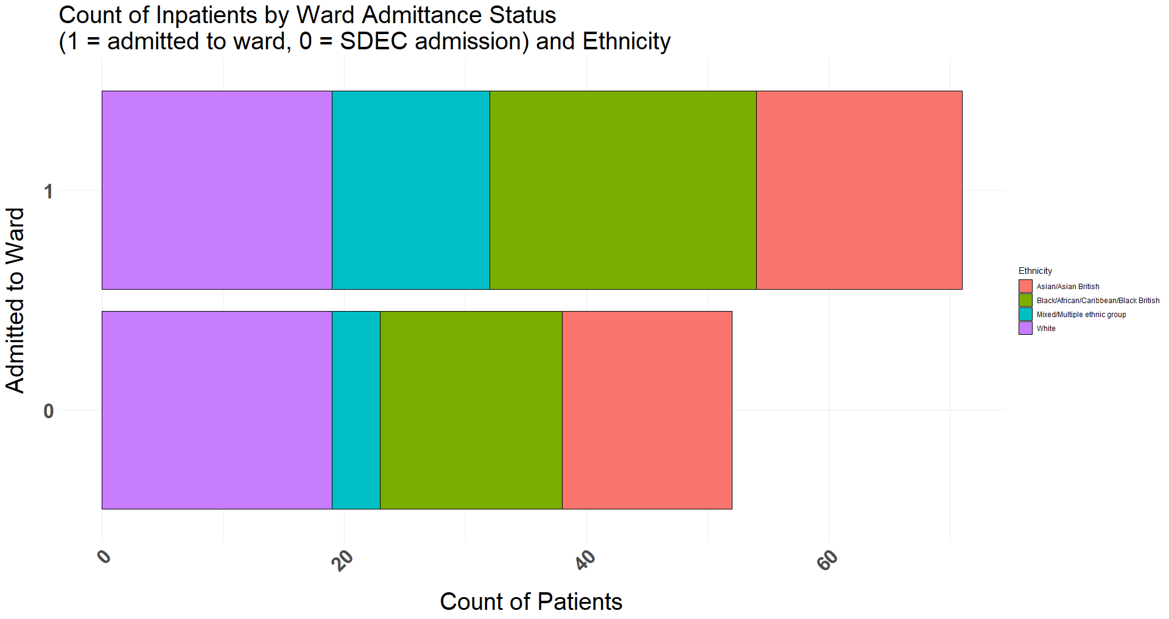
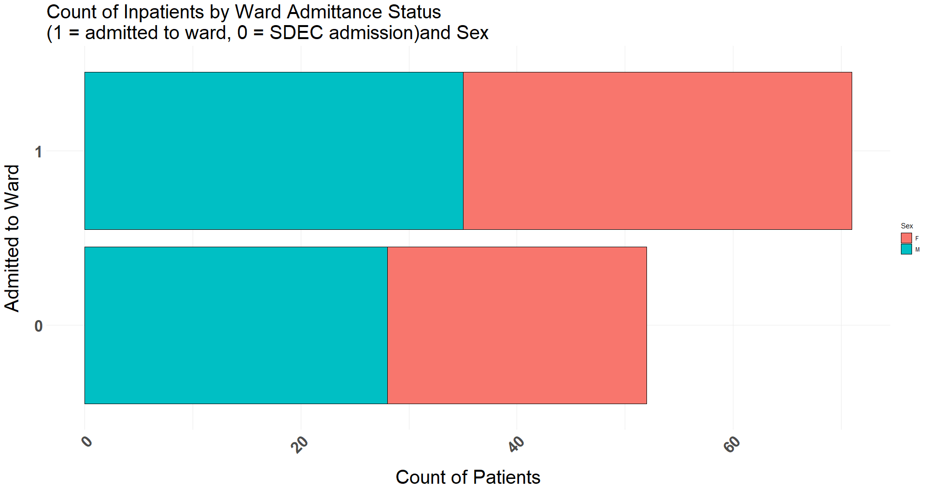
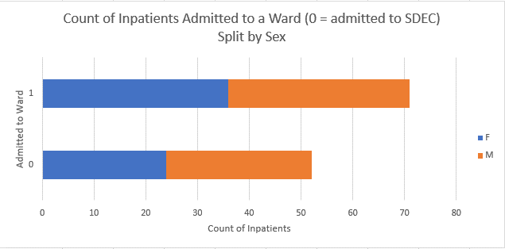
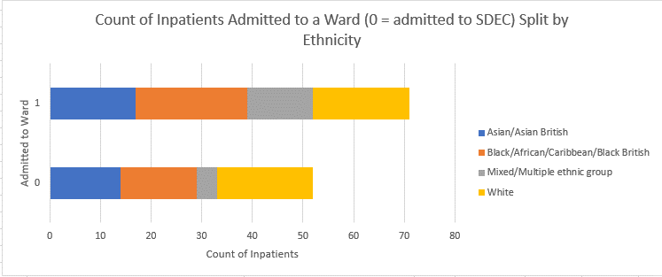
Discrete Data Practical – Bar Charts Part 2
R:
Run lines 224-240 to create a stacked bar chart showing the number of patients that were admitted to a ward (rather than SDEC), split by Sex. We are only adding few extra lines of code. Check the comments to understand the changes
Have a go at task 6 to split the bars by ethnicity
Excel:
Go to your pivot table and ensure only Admitted_To_Ward is in the Rows field. Leave Count_of_Patient_Id in the Values field
Add Sex to the pivot table in the Columns field (A118)
The column names may stay the same as the previous title you gave them, if so, rename them to something more suitable
Your bar chart should update, however it may appear as a clustered bar chart (this is what we selected earlier)
Click on the chart and go to Design in the ribbon. Click Change Chart Type (far right) and select stacked bar chart. Your chart should now look like the one on this slide. If it still doesn’t look right, you might need to drag Sex into the Legend (Series) box. Ask for help if you have any problems (D118)
Rename the chart title and axis titles appropriately
You can click on the chart and press the + on the upper right and have a play around e.g. add the legend
Have a go at question 5 to split the bars by ethnicity (A135-H135)

Slide 12
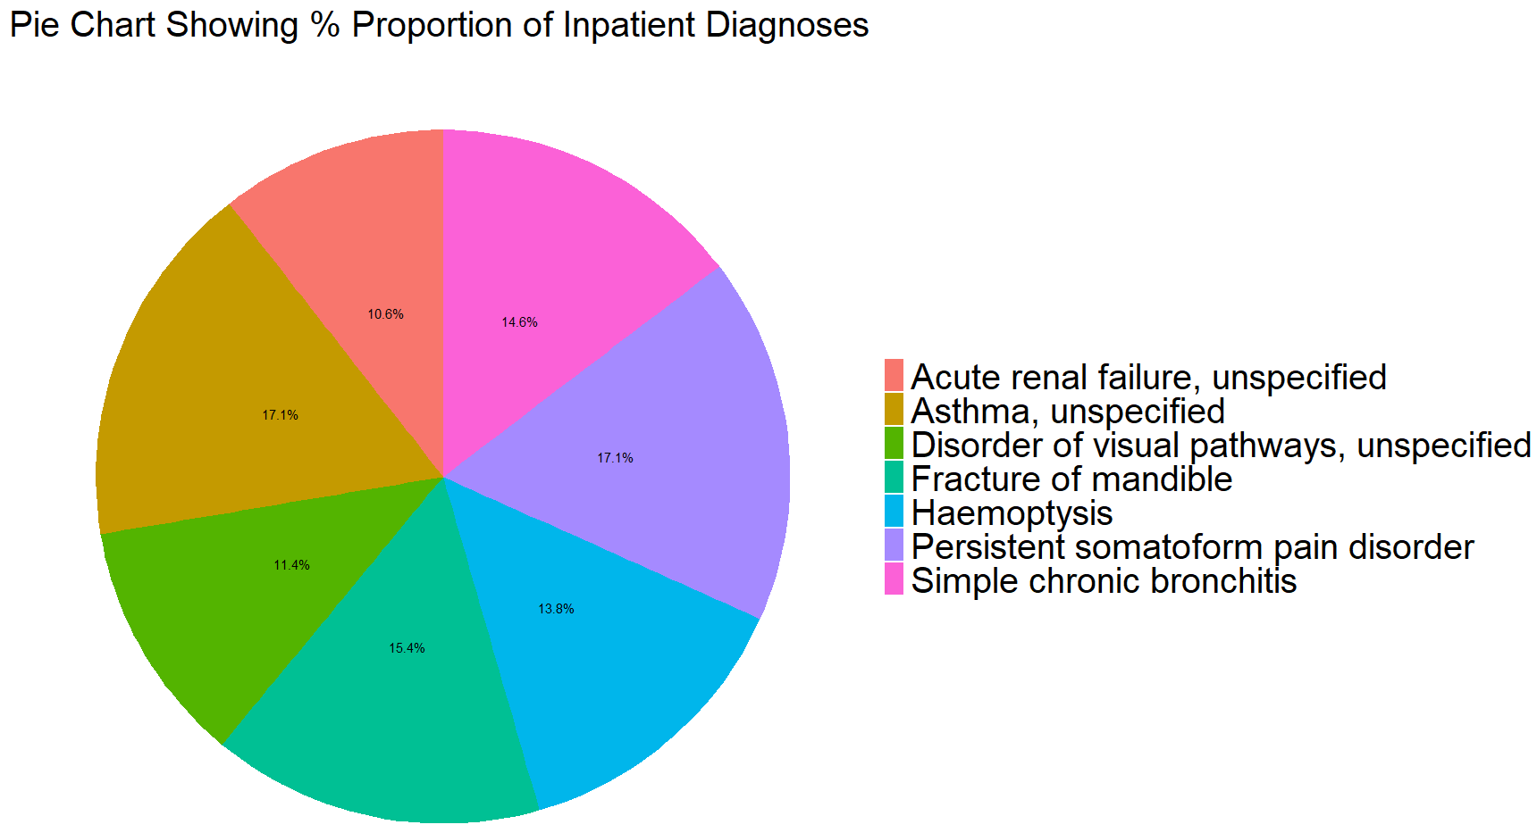
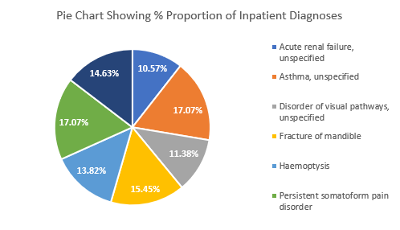
Discrete Data Practical – Pie Charts
R:
Run lines 273-278 to re-run the frequency proportion table from earlier. Line 194 adds in a new column that we can use for the data labels on our chart.
Run lines 282-286 to create a simple pie chart.
Run lines 290-300 to create a more customised pie chart. Remember to read the comments to understand each line of code. You can have a go at changing some things if you want to play around
Have a go at task 7 to make a pie chart showing the Ethnicity split. This task might be a bit more tricky than the previous as in the chart there are lots of elements that you have to change. Have a go and look at the hints or ask for help if you get stuck
Excel:
Lets change the pivot table back to show the proportion of diagnoses. Go to the pivot table and rearrange so you have Diagnosis_ICD10_Description in rows and Patient_Id into values (remember to ensure this is count not sum. If sum, click on Patient_Id in the pivot table fields on the right, select Value Field Settings, and select count)
Right click on one of the values in the pivot table and select Show Values As, % Of Column Total (A151)
Go to Insert on the ribbon, Pie Chart, 2D Pie Chart
If you prefer, you can remove the buttons on the chart the same way as before (right click on any button and select remove all buttons)
Give the chart an appropriate title and play around with The features by clicking on the chart and then the + in the upper right e.g. add data labels (when I added data labels, one of the labels couldn’t be seen due to the text and background colour. Click on the labels and change their colour/style using the Home section of the ribbon) (D151)
Have a go at question 7 to make a pie chart showing the Ethnicity split. Have a go and look at the hints or ask for help if you get stuck (A167-D167)

Slide 13
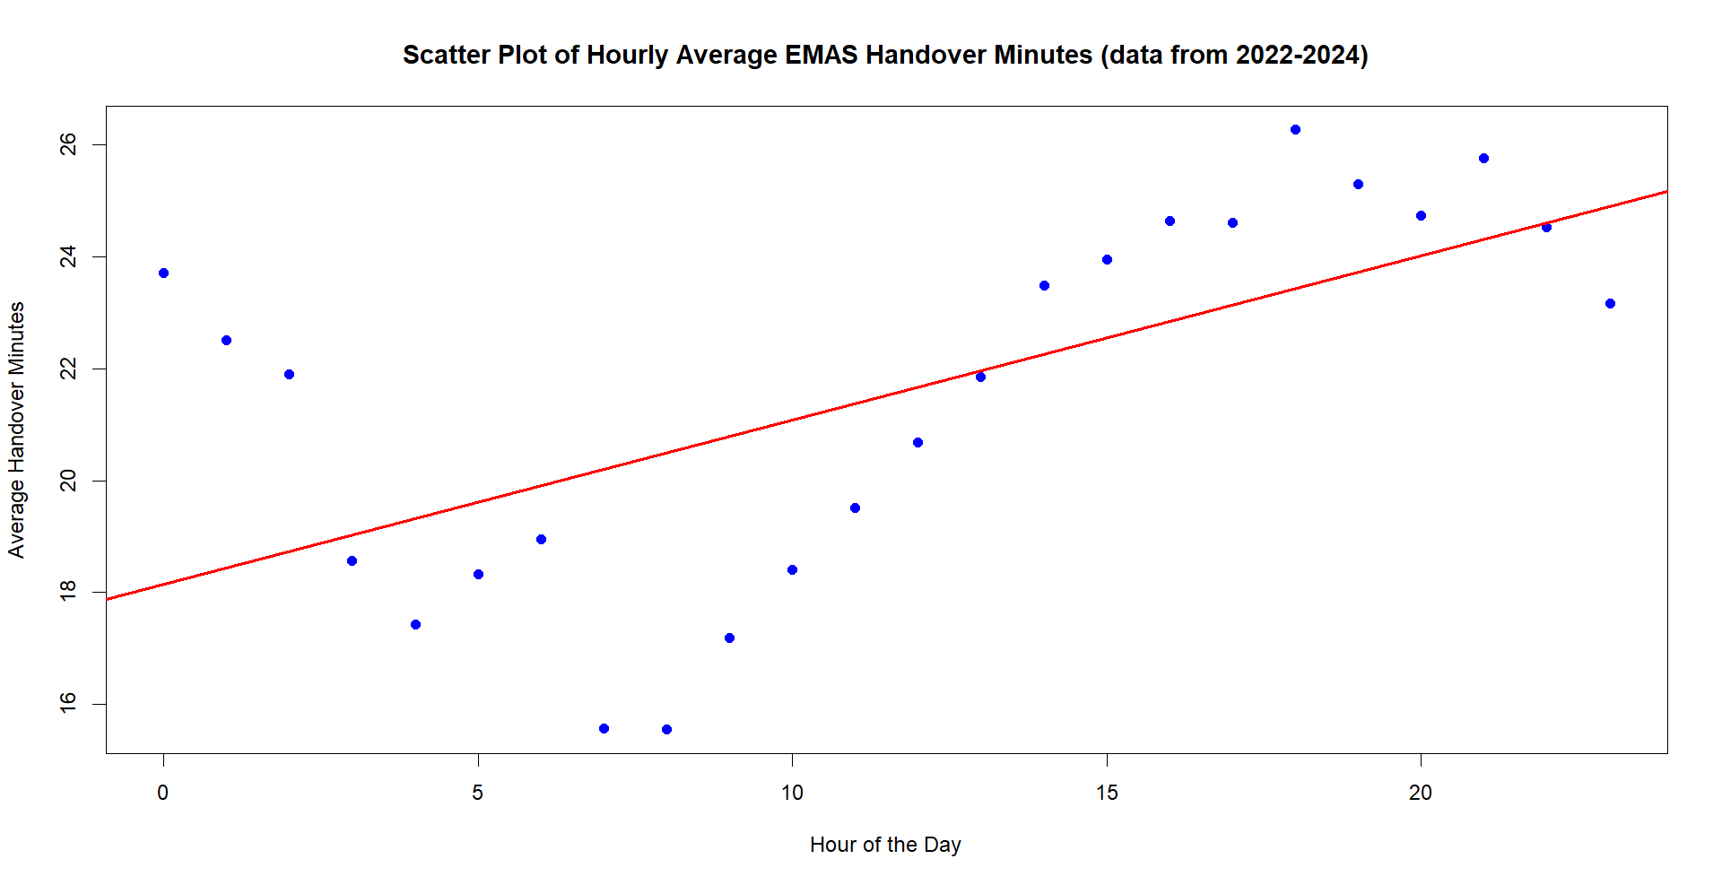
Continuous Data

Slide 14
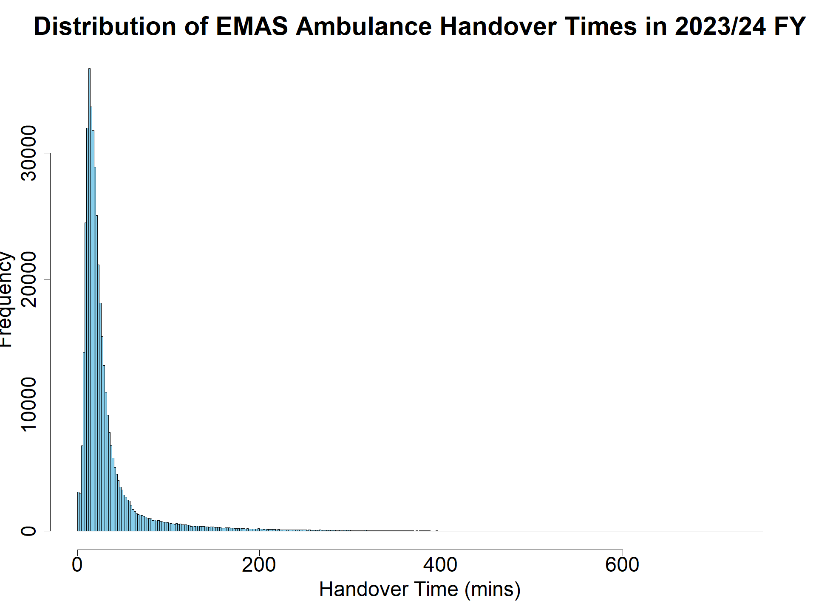
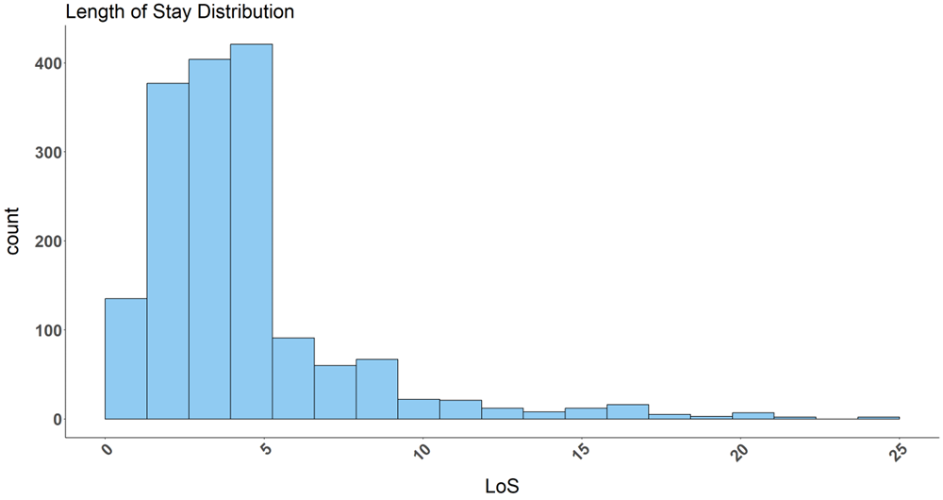
Continuous Data
QUESTION: WHAT DO WE MEAN BY DATA BUCKETS/BINS?

Slide 15

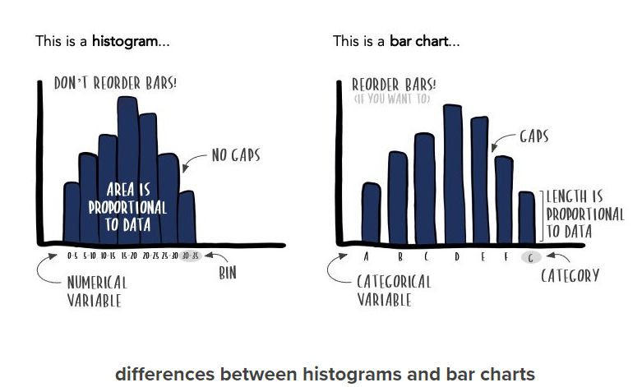
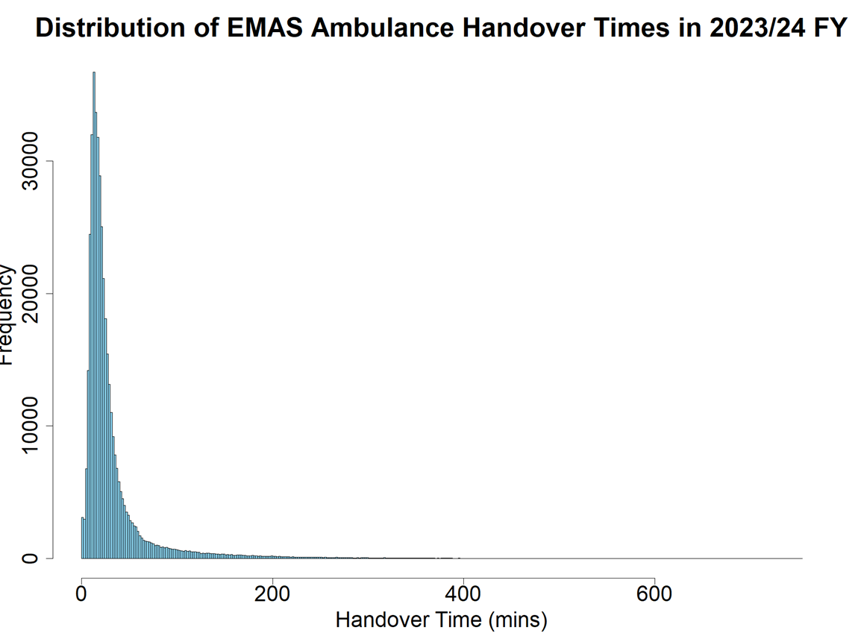
Continuous Data – Histogram vs Bar/Column Chart
StorytellingWithData, accessed 03.07.24 https://www.storytellingwithdata.com/blog/2021/1/28/histograms-and-bar-charts

Slide 16
Continuous Data Practical – Histograms
R:
Run lines 346-357 & have a look at the histogram. What does it tell you? Read the comments to see how to e.g. select the bin method.
Have a go at task 8 to use different binning methods. Please feel free to ask for help if required
Excel:
Have a go at the question 8 in the Questions tab
Go to the Continuous_Ambulance_Handovers tab and select Data Analysis from the Data tab in the ribbon
Select histogram and click ok.
Click in the white box next to input range and highlight the data in column A of the Continuous_Ambulance_Handovers sheet (highlight the first cell in column A and then ctrl+shift+down arrow)
Click in the white box next to output range and select any cell in the sheet where you would like the histogram data to be written
Tick the chart output box and click ok (A184-D184)
Have a go at question 9 to change the bins by following these steps: (A842-D842)
Anywhere on the sheet, create a new column called bins i.e. write bins into a cell
Order Handover_Minutes so you can see the range of values your bins need to encompass
Under the bins header (step 8), write out your bin values. If you want your bins to increase in increments of 15 for example, write 15 in the cell under bins
Then, you can click on the cell under 15, and write = and then use the up arrow to select the cell with the number 15, and then type +15 and press enter
You can then drag this box down until you reach a high enough bin to cover your highest Handover_Minutes values. Please feel free to ask for help if required
DISCRETE OR CONTINUOUS?
Ambulance handover times in minutes =
Length of stay in days:hours:minutes:seconds =
Length of stay in days =
Birthweight in pounds =
C
C
D
C

Slide 17
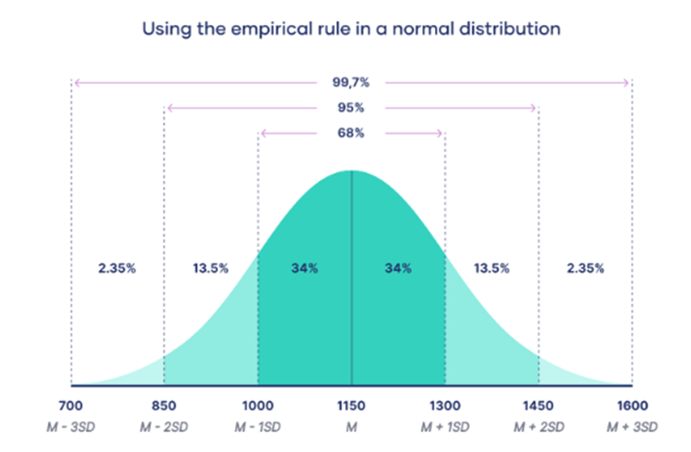
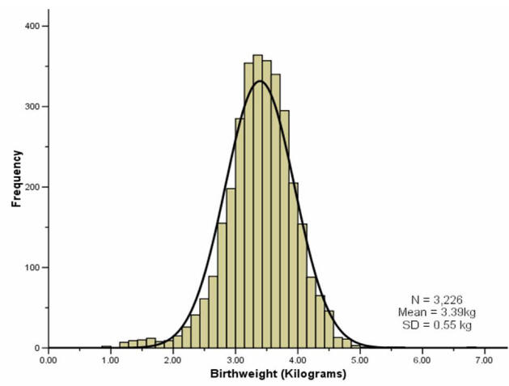
Normal Distribution
MEAN = MEDIAN = MODE
Scribbr, accessed 01.07.24 https://www.scribbr.co.uk/stats/the-normal-distribution/
Why does normal distribution matter?
It is quite common, therefore many statistical tests e.g. ANOVA, t-test etc. assume your data is normally distributed.
Using inferential statistics, you can make educated estimations about a larger population than your sample.
-ve infinity
+ve infinity
UK Faculty of Public Health, accessed 03.07.24 https://www.healthknowledge.org.uk/public-health-textbook/research-methods/1b-statistical-methods/statistical-distributions

Slide 18
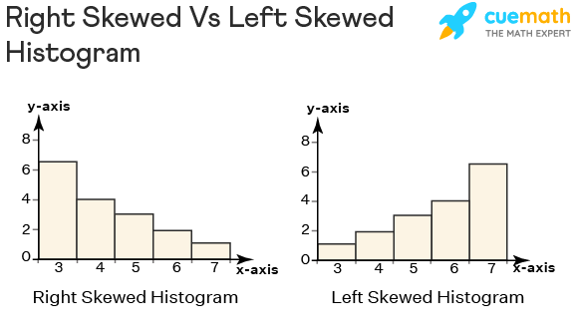
Skewed Distribution
POSITIVELY/RIGHT SKEWED
POSITIVELY/RIGHT SKEWED
cuemath, accessed 01.07.24 https://www.cuemath.com/data/right-skewed-histogram/

Slide 19
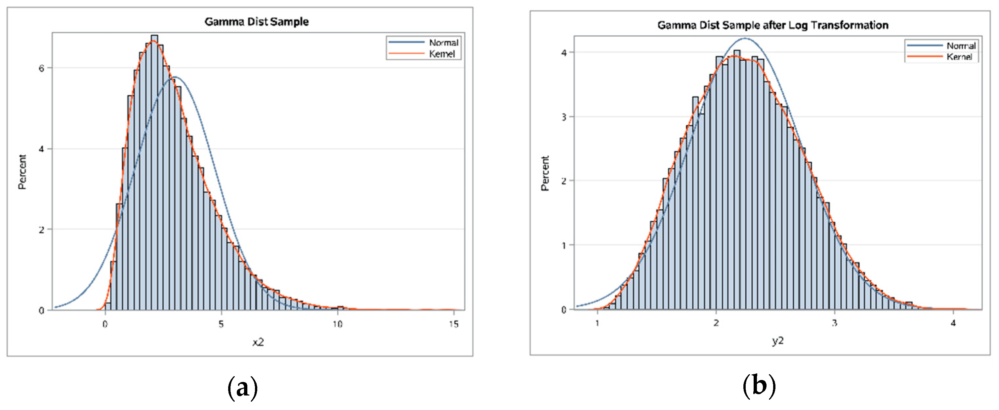
Skewed Distribution – Log Transformation
Handling Skewed Data: A Comparison of Two Popular Methods accessed 01.07.24 https://www.mdpi.com/2076-3417/10/18/6247

Slide 20
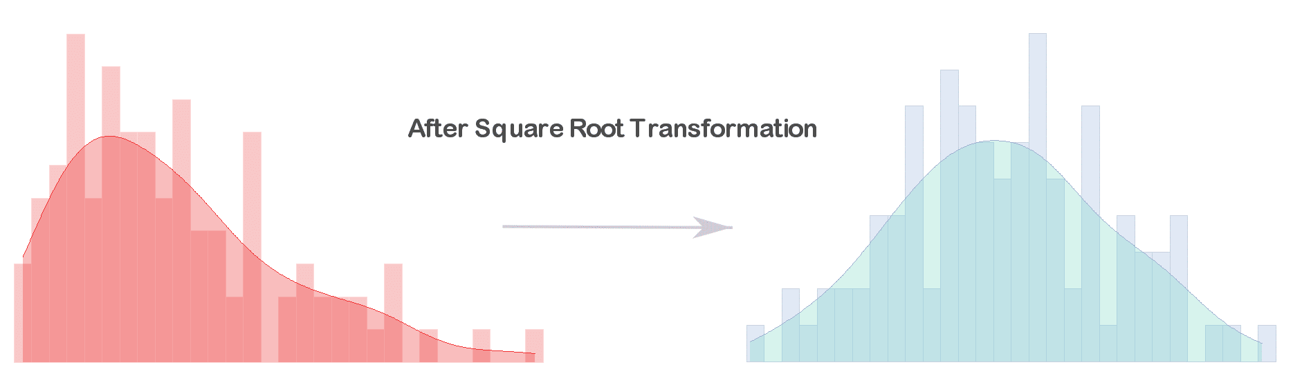
Skewed Distribution – Square Root Transformation
Quantifying Health, accessed 01.07.24 https://quantifyinghealth.com/square-root-transformation/

Slide 21
Summary Measures – Measures of Central Tendency
Measure | Description | Suitable Data Types
Mean | Average that helps indicate the centre of the data Sum all values and divide by number of values Can be heavily skewed by outliers | Normally distributed continuous Numerical discrete that does not have very high or very low outliers E.g. Birthweight, square-root transformed ambulance handover times
Median | Centre of the data set when values are arranged in numerical order | Skewed continuous Discrete numerical with outliers in data E.g. LOS
Mode | The most frequent value | Not used very often Useful in epidemiology e.g. to find the most common virus during an outbreak

Slide 22
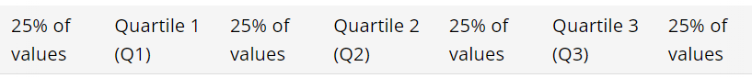
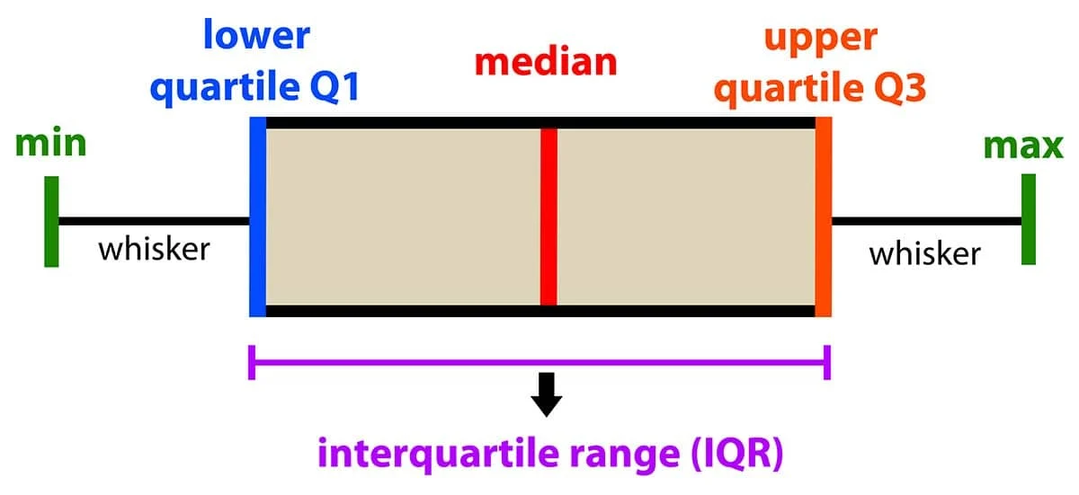
Summary Measures – Measures of Data Spread
Measure | Description | Suitable Data Types
Range | Smallest value subtracted from largest value Helps understand variability in data Is skewed by even 1 very high or very low outlier | Normally distributed continuous Numerical discrete without outliers
Interquartile Range | Q3 – Q1 Arrange data in ascending order. Median = Q2. Median of data left of Q2 = Q1. Median of data right of Q2 = Q3 Describes middle 50% of data Not affected by outliers | Skewed continuous Numerical discrete with outliers
Standard Deviation | Square root of the variation Measures how spread out the data is, relative to the mean Higer SD can indicate more volatility in data Useful for comparing consistency between 2 data sets | Normally distributed continuous Compare between data sets – 2 sets of data could have same mean, median, range, but have very different data. SD would help highlight this.
Australian Beureau of Statistics, accessed 01.07.24 https://www.abs.gov.au/statistics/understanding-statistics/statistical-terms-and-concepts/measures-spread#:~:text=and%20concepts%20glossary-,Definition,range%2C%20variance%20and%20standard%20deviation.
SimplyPsychology, accessed 01.07.24 https://www.simplypsychology.org/boxplots.html

Slide 23
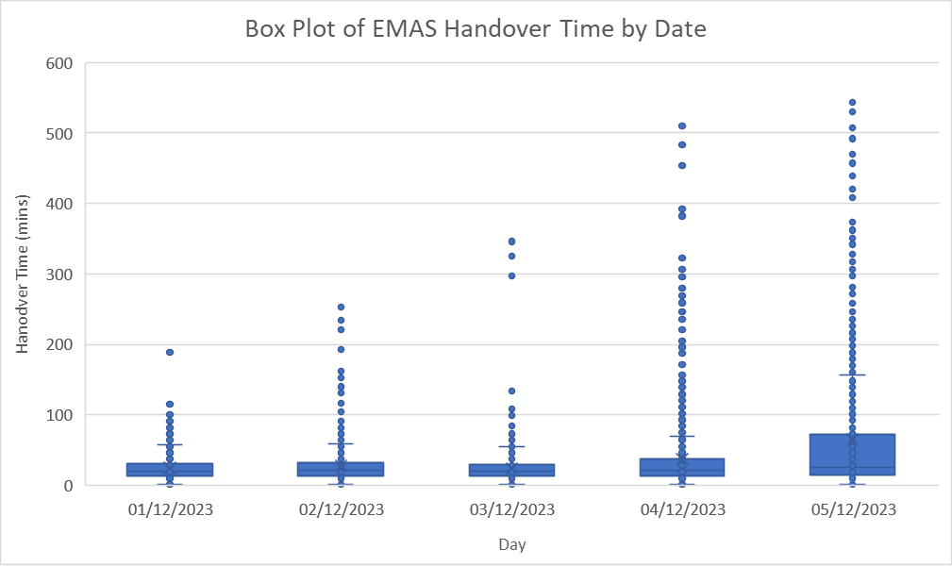
Summary Measures – Box Plot Practical
R:
Run lines 401-406 to prepare data and reduce size of sample to allow comparison of boxplots showing EMAS handover times across a range of days
Run lines 409-420 to create a box plot (remember to read comments to understand each line of code)
Have a go at answering question 9 about the box plot (we will go over answers in the next slide)
Excel:
Go to the tab called Continuous_Ambulance_Handovers
Highlight column B and turn on Filter (Data tab of the ribbon)
Filter Date column to only include 2023-12-01 to 2023-12-05 (should have 5752 rows)
Go to the inset tab of the ribbon and select statistic chart, box and whisker
Go to chart design and click select data
Remove any data already in either box. Click Add in Legend Series and click the lower white box. Select the data in column Handover_Minutes. Give the series an appropriate name (upper white box). Click ok.
Click Edit in Horizontal Axis Labels and click the white box. Select the data in column B. Click ok. Click ok in main box to create box plot.
Sort column B by Date ascending to order the box plots (A901)
Have a go at the question 10 (we will answer these in the next slide)
SimplyPsychology, accessed 01.07.24 https://www.simplypsychology.org/boxplots.html

Slide 24
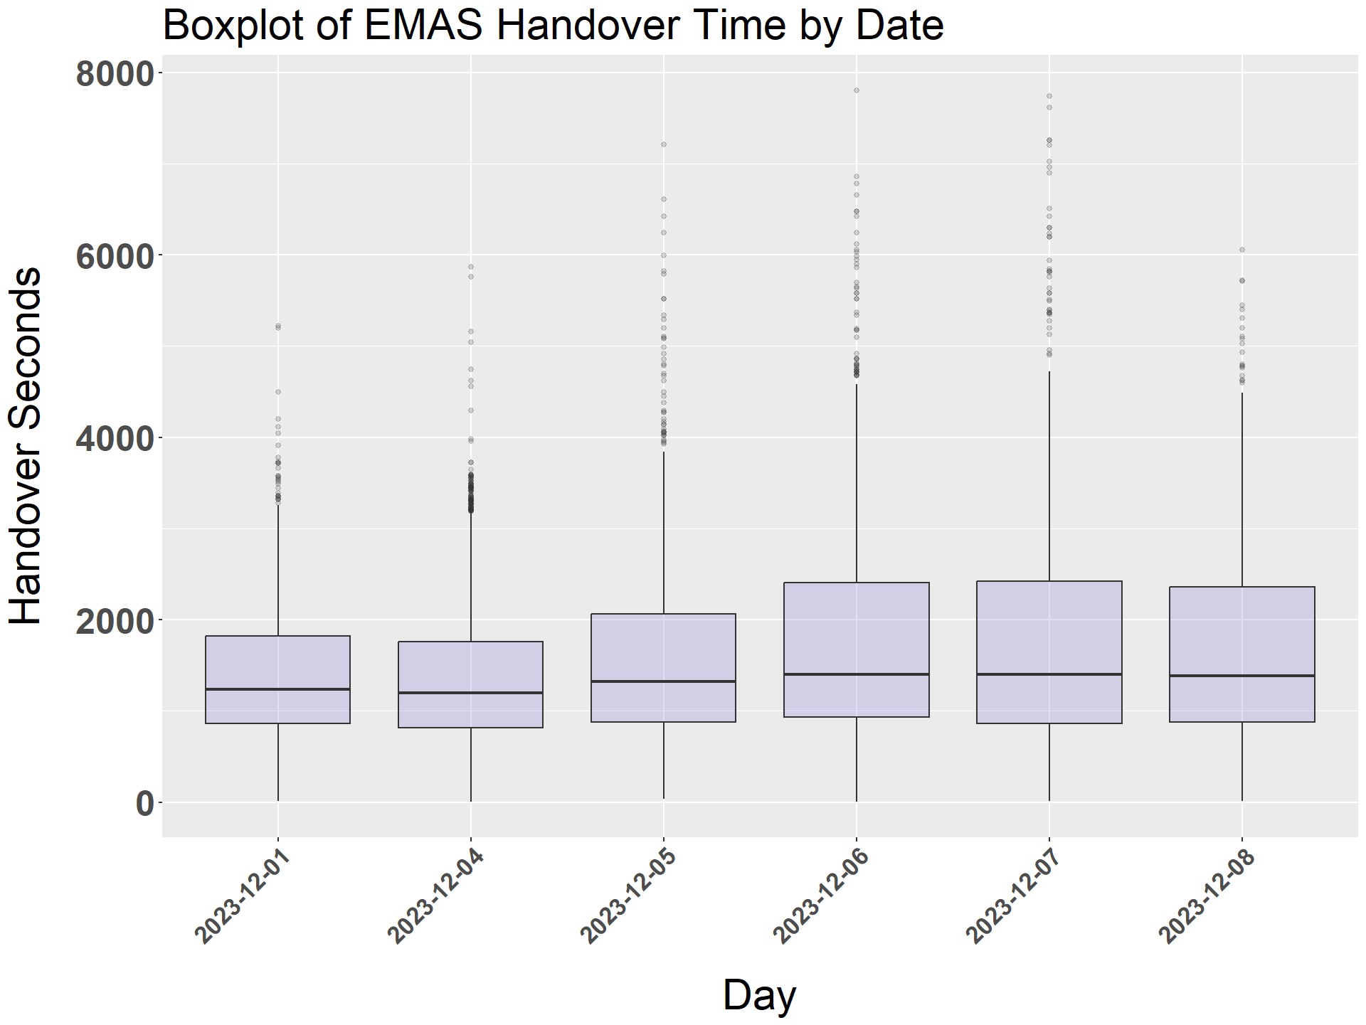
Summary Measures – Box Plot Practical
QUESTIONS:
1: Which day has the single highest handover time value (excl. outliers – ignore dots)?
2: How would you describe the median/Q2 value across all 5 days?
3: Which day has the highest Q3 value?
4: How would you describe the Q1 value across all 5 days?
5: Which day has the largest spread across the middle 50% of the data?
ADD X1.5
2023-12-05
Fairly constant
2023-12-05
SUBTRACT
X1.5
Fairly constant
2023-12-05

Slide 25
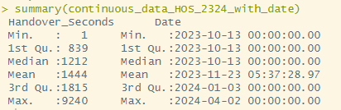
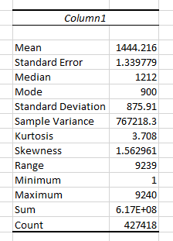
Summary Measures – Basic Summary Measure Overview Practical
R:
Run line 441 to produce a simple summary of some measures
Have a look at the different measures and what they indicate about the data. Are they what you expected? Does anything surprise you?
Excel:
Go to the Continuous_Ambulance_Handovers tab
Go to Data in the ribbon and select Data Analysis
Select “Descriptive Statistics” and press ok
Click in the white box next to input range and highlight the data from column Handover_Minutes of the Continuous_Ambulance_Handovers sheet (click on cell A2 and then ctrl+shift+down arrow)
Click in the white box next to output range and select any cell in the sheet where you would like the summary measures to be written
Tick Summary Statistics if not already ticked
Click ok
Your summary measures will appear! (A923)

Slide 26
Summary
 | DISCRETE DATA |  |  | CONTINUOUS DATA
 | Categorical | High Variance Numerical | Low Variance Numerical | Normal Distribution | Skewed Distribution
Visualisations | Bar/column charts Pie charts Frequency tables | Bar/column charts Pie charts Frequency tables Box plots (IQR) | Bar/column charts Pie charts Frequency tables | Histogram Scatter plot (2x continuous variables) | Transformed(e.g. log, square root etc.) histogram Scatter plot (2x continuous variables)
Measures of Central Tendency | N/A | Median | Mean Median | Mean Median | Median
Measures of Data Spread | N/A | Interquartile range | Range | Range Standard deviation | Interquartile range

Slide 27
Skewed Distribution – Log Transformation Practical
R:
Run lines 448-451 to prepare the data and generate the log transformed data
Run lines 454-464 to create the log transformed histogram
Have a go at question 10. We will go over the answers together on the next slide
Excel:
Go to the histogram you made earlier with the default binning method rather than your custom bins (the actual chart, not an image that you may have pasted)
Select the y axis (the numbers, not the label) and right click
Select “Format Axis”
Scroll down and tick “Logarithmic scale”. Ensure the log base is 10 (A941)
Have a go at question 11. We will go over the answers together on the next slide
QUESTION: HOW WOULD WE DESCRIBE THE LOG TRANSFROMED EMAS FREQUENCY DISTRIBUTION?

Slide 28
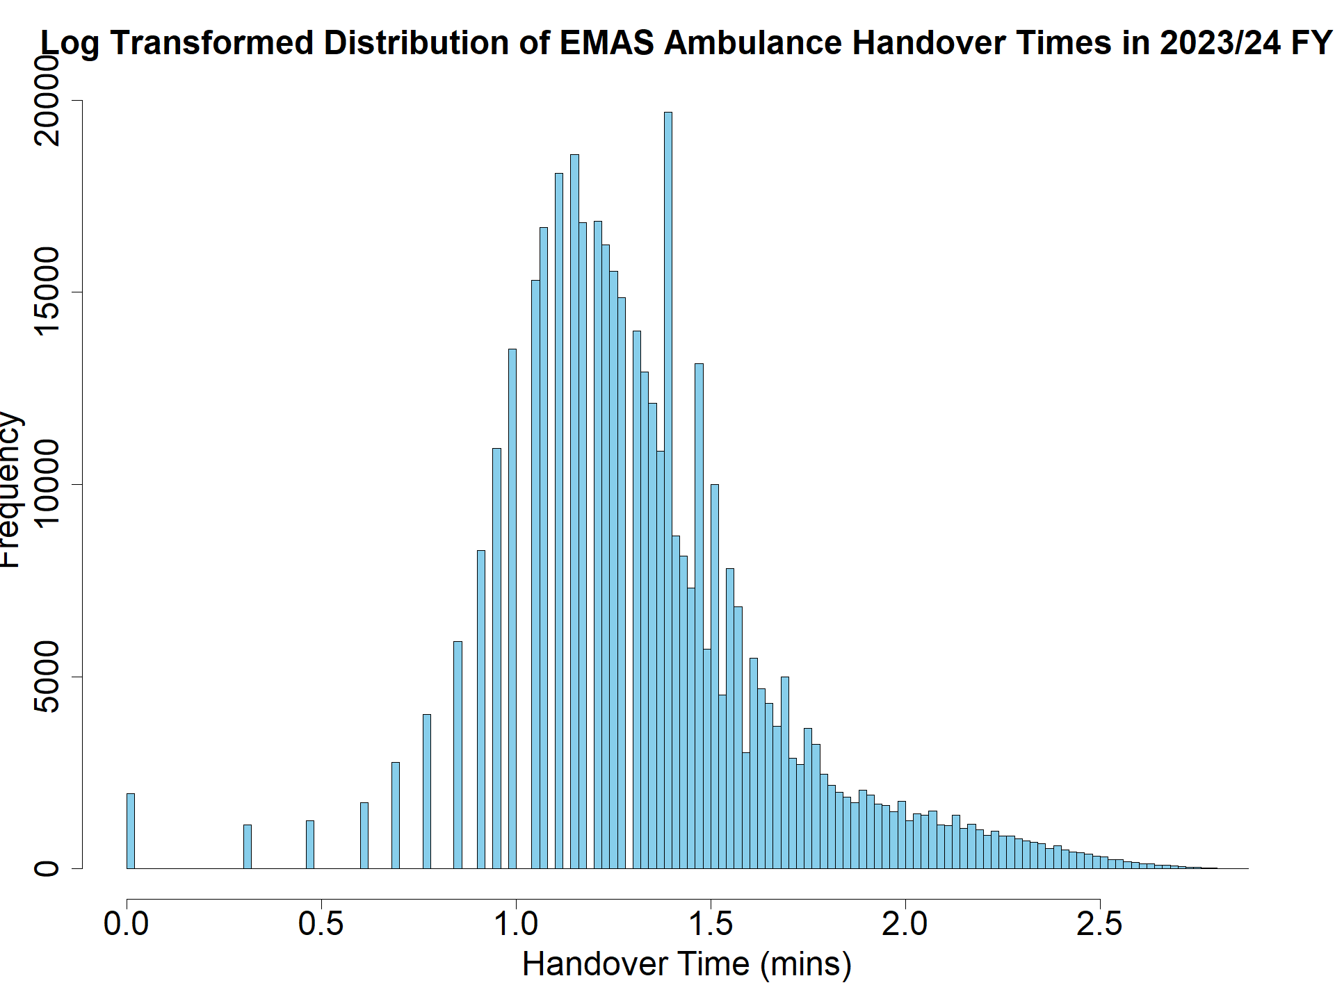
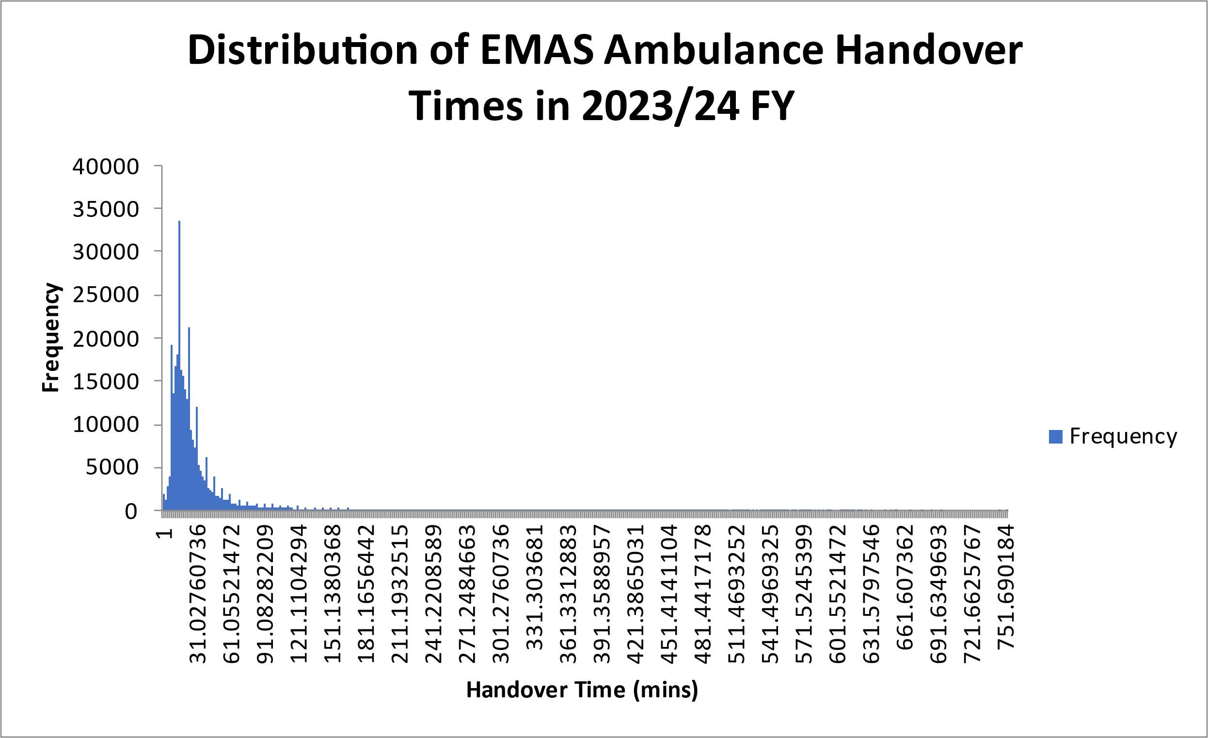
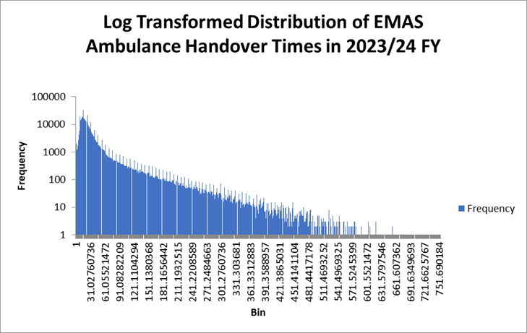
Skewed Distribution – Log Transformation Practical
The Log transformed histograms in R and Excel look different. To calculate the bins, we have explicitly stated we want to use Scott’s rule in R, and this is the default binning method in Excel. However, there are probably slight discrepancies between how Scott’s rule is applied to the data between the 2 programmes.
Notes:
Log transformation – if you have a lot of values at lower values especially – can get gaps between bars. Will have happened due to higher concentration of handovers around 15 min mark. But looks better, more normally distributed.

Slide 29
Skewed Distribution – Square Root Transformation Practical
R:
Run lines 476-478 to prepare the data and generate the square root values
Run lines 481-492 to create the transformed histogram
Have a go at question 11 and we will go through answers together on the next slide
Excel:
Go to the Continuous_Ambulance_Handovers tab
In an empty column (ensure it’s row 1) write a suitable name for the column that will hold your square root handover time values e.g. Square_Root_Value
In the cell underneath write = SQRT(A2) and press enter
Click in the cell with your formula (SQRT(A2)) and then scroll down to the last row of column A
Hold shift and click the cell in your square root value column corresponding to the last row of column A
Press cntrl + D and the remaining square root values should populate (this can be a bit fiddly so let me know if you have problems)
Select Data Analysis from the Data tab in the ribbon
Select histogram and click ok.
Click in the white box next to input range and highlight the data in column B of the Continuous_Data_HOS_2324 sheet (click on the B1 and then ctrl+shift+down arrow)
Click in the white box next to output range and select any cell in the sheet where you would like the histogram data to be written
Tick the chart output box
Click ok (A1598 – D1598)
Have a go at question 12 and we will go through answers together on the next slide
QUESTION: HOW WOULD WE DESCRIBE THE SQUARE ROOT TRANSFROMED EMAS FREQUENCY DISTRIBUTION?

Slide 30
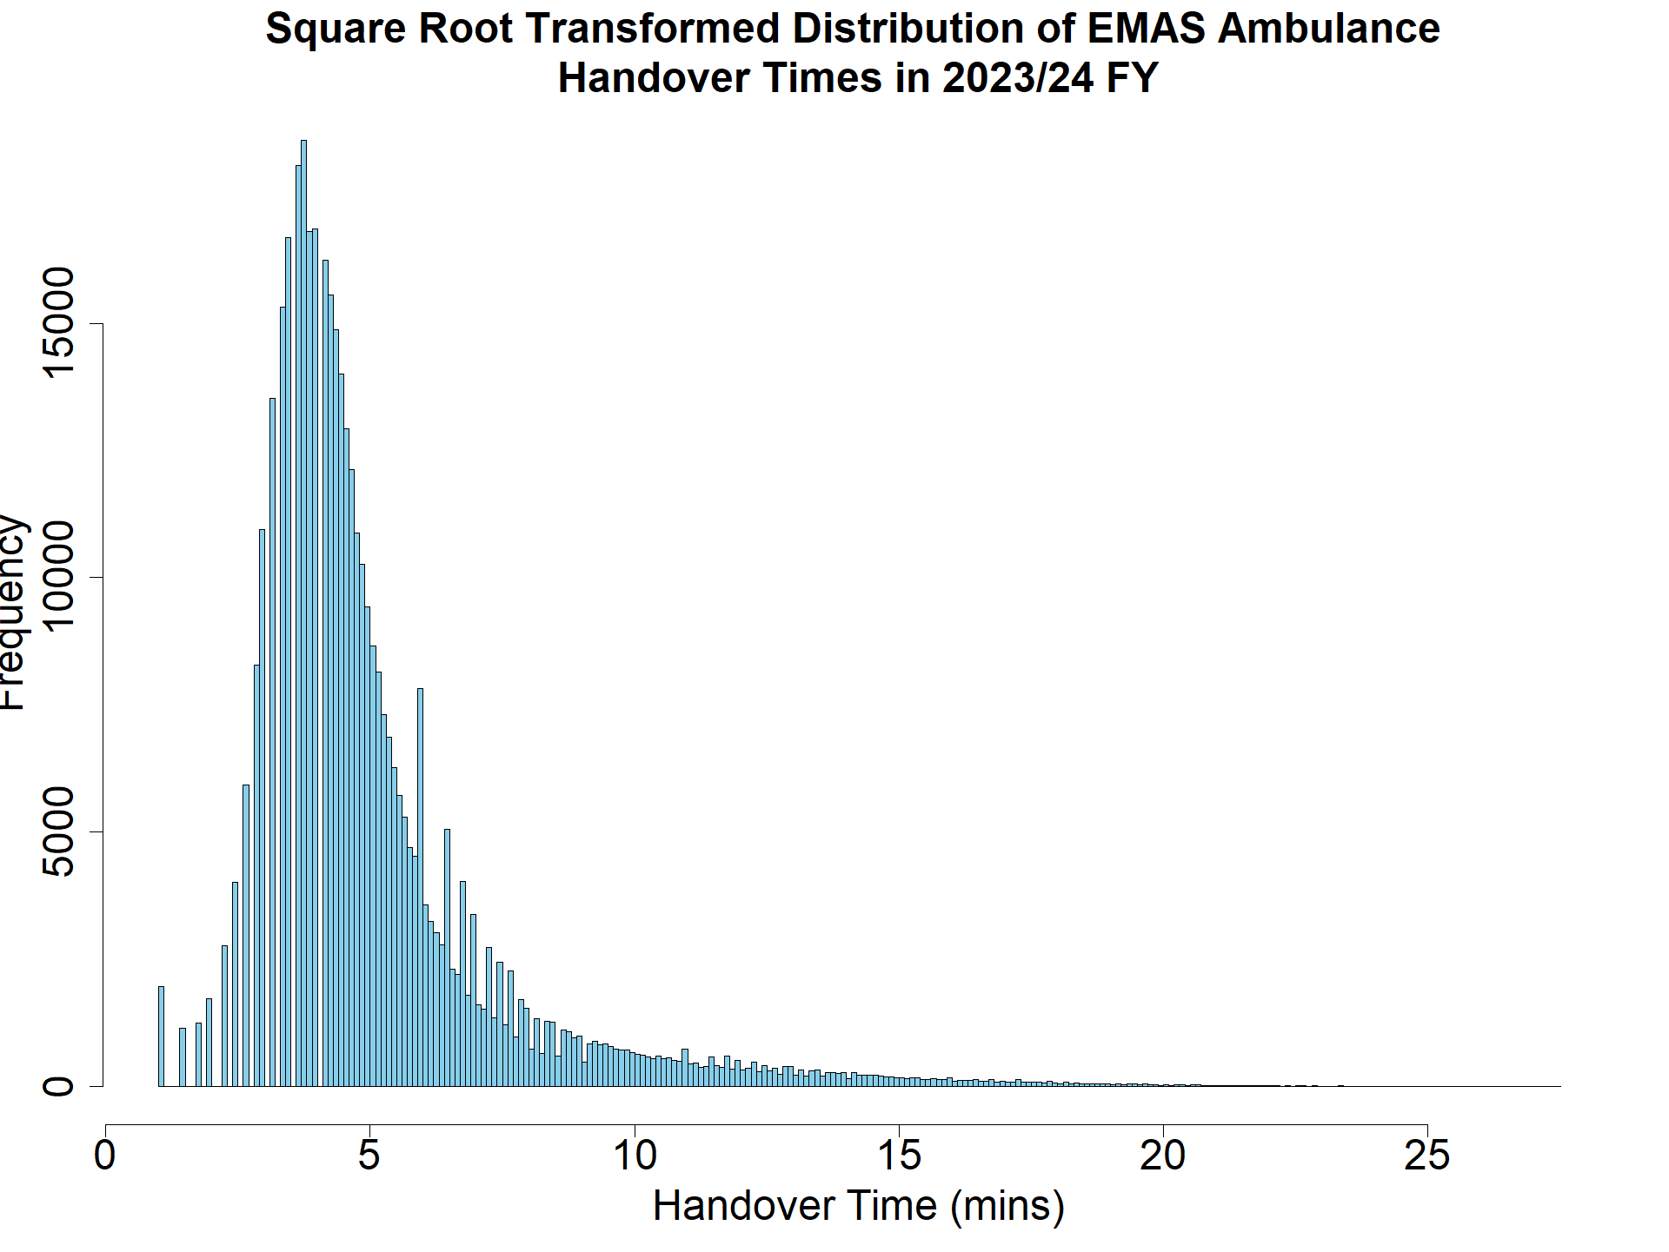

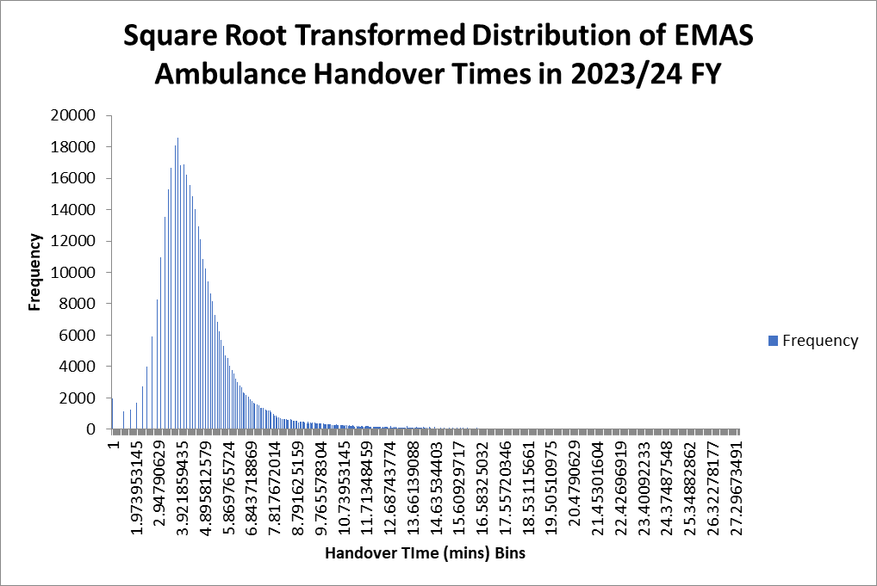
Skewed Distribution – Square Root Transformation Practical

Slide 31

Contact & Resources
We really hope you enjoyed this training and found it useful. I would welcome any feedback (especially constructive) regarding how this session could be improved in the future. Please also feel free to reach out with any questions. You can contact me with feedback and/or questions on amy.makawana1@nhs.net
There is a comprehensive list of resources available in the Statistics Training Notes Word document available via the GitHub page:
A Reminder of Resources Available from this Training Session:
Statistics Training Notes Word document
This PowerPoint
Data for Statistics Training NNICB Excel Document:
Data for both R and Excel practicals
Excel model answers
Excel questions & tasks answers
Statistics Training Practical R file
Statistics Training Answers R file
The NNICB Stats Training Github page!

